Slide 1
Import Excel
EXCEL FILE
1
2
3
Correct Products List
Error Products List
Duplicate Products List

Slide 2
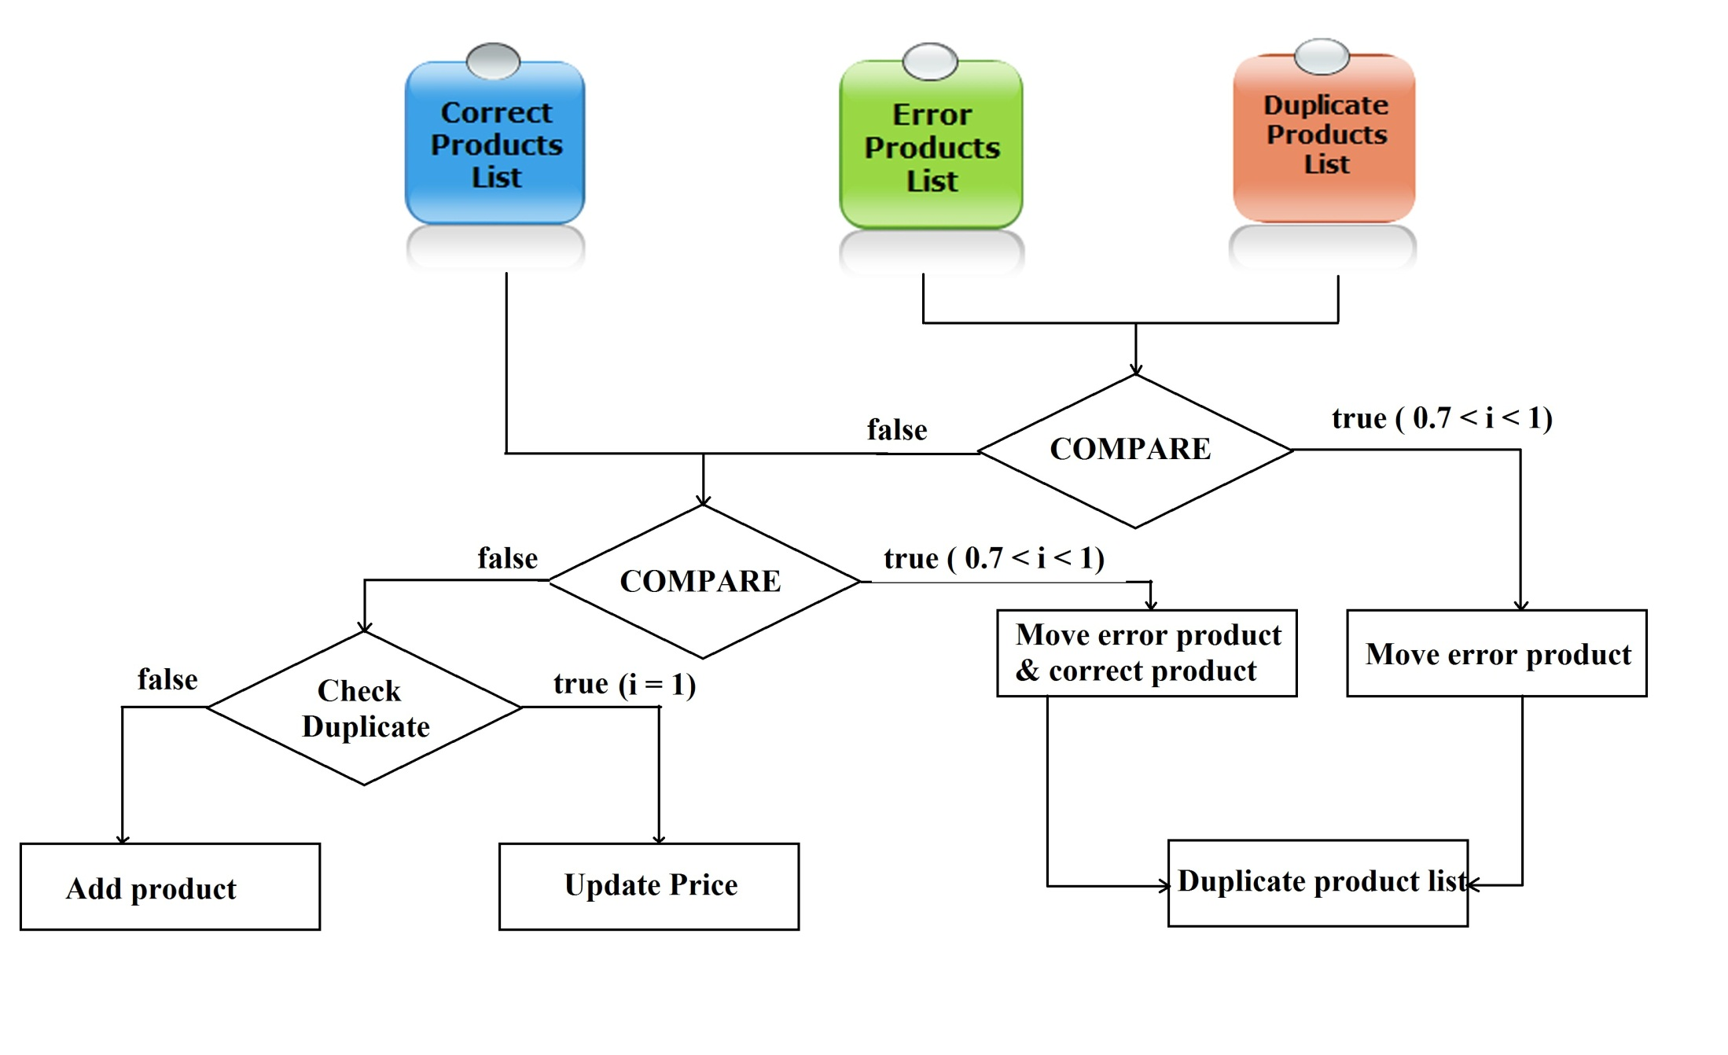
Compare products

